Slide 1
Autumn activities
Thinking about a child's development

Slide 2
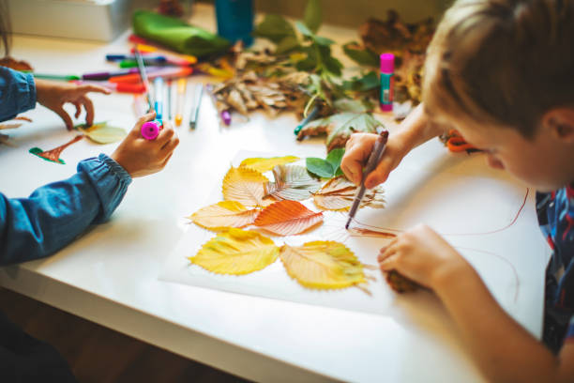
Areas of development
Cognition
Neurological and brain development
Speech, language and communication
Physical
Personal, social and emotion

Slide 3
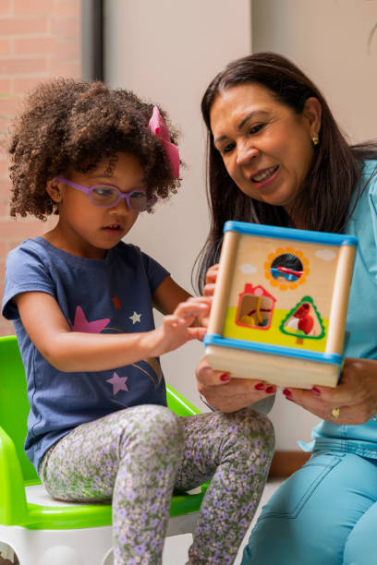
Cognitive development
Cognitive development means how children think, explore and figure things out. It is the development of knowledge, skills, problem solving and dispositions
Give opportunities to think and find out. Offer lots of autumn items to look at. Plus where they come from.

Slide 4
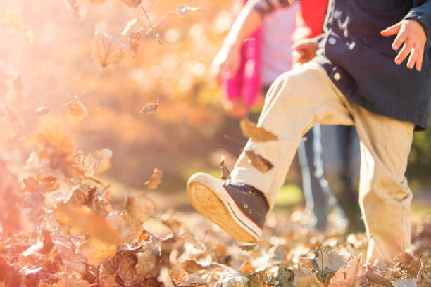
Physical development
Think Gross motor skills
Fine motor skills
Balance and stabilisation
Running, walking, skipping and many more
Activities: Go to the park try to find autumn items, leaves, acorns, conkers, and cones. Get a picture and challenge the children to find them

Slide 5
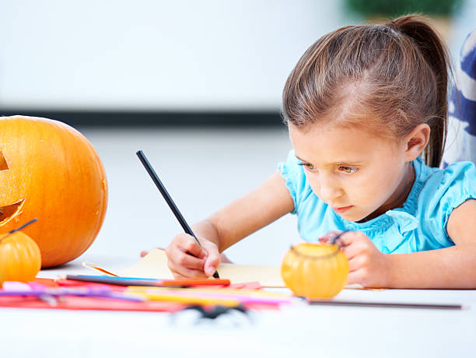
Grasp stages: Think age and development
Inferior pincer grasp
Superior pincer grasp
Static tripod grasp
Dynamic tripod grasp
Activites: When creating a painting/drawing we can offer ranges of size of brushes /crayons/pencils
Plus offer items to pick up of different sizes

Slide 6
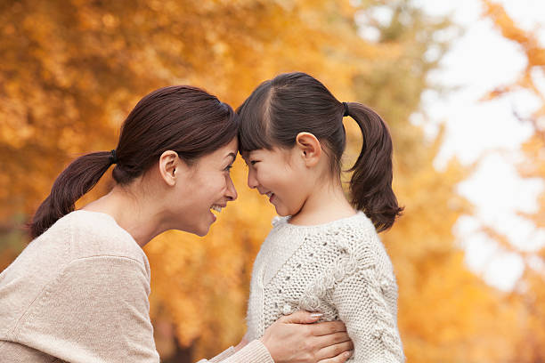
Personal, Social and Emotional development
Self esteem: The way you feel about yourself
Self – concept: how you see yourself can be called self image
Activities: When collecting ask for a number of the items, colour, add them to your photos and praise when achieved. This helps children have a sense of achievement supports and encourages self esteem.

Slide 7
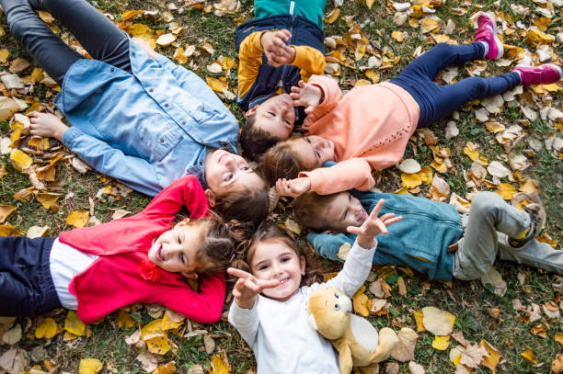
Temperament and behaviour
Goodness of fit
Personality
Temperament
Activity: help children learn to enjoy outdoors and discover nature. If possible make it with others so this becomes a fun social event. The children learn how to cope with different personalities, and characters too

Slide 8
Conclude
So you can see that we can include all the development needs by offering children a variety of activities.
As a professional practitioner no activity is just there, we plan for areas of development, helping children achieve.
We observe children to see if we need to offer extra help by being guided on development and age. By doing this we can then help the children reach their potential and build confidence and self esteem.
Think about all activities, from craft, theme, physical activities, intellectual, communication, and social.

